Slide 1

Integration of I4.0 standards
Alina Arunova, Maxim Maltsev, Philipp Matyash, Sattar Rahimbeyli
Mentor: Irlán Grangel

Slide 2

System Documentation
High-level plan;
Requirements;
Architecture;
System overview.
Sequence diagram;
User manual.
Code specifications for Back-end;
Code specifications for Front-end.
Technical
End - user
Code
2

Slide 3
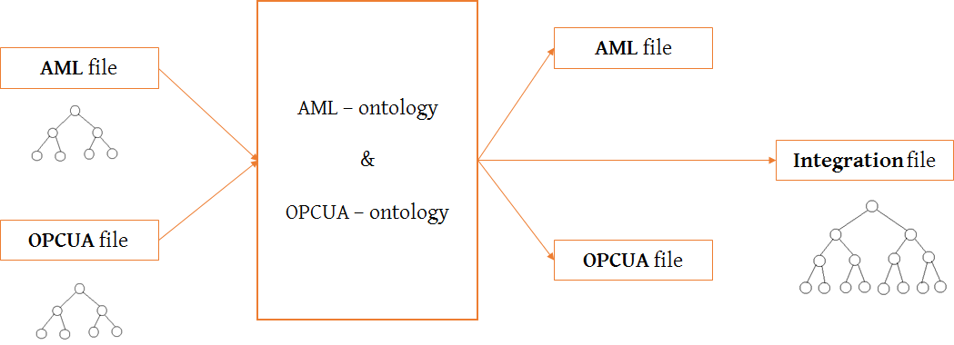
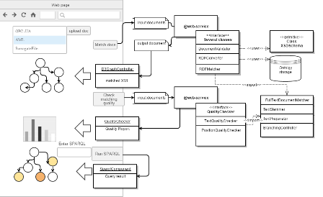
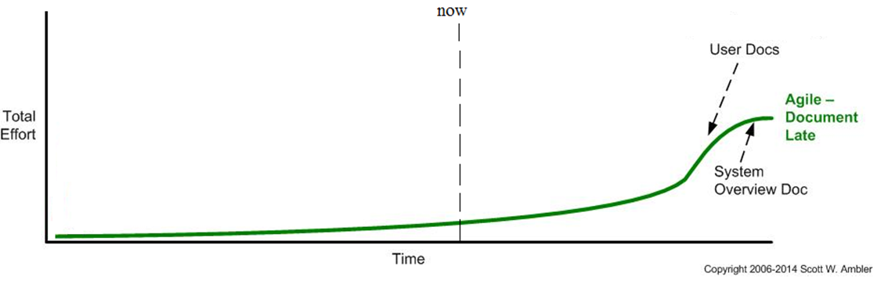
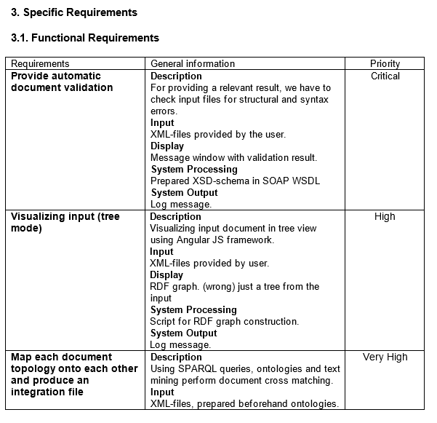
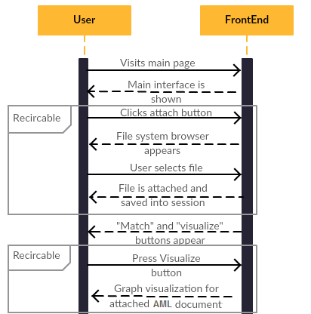
Agile – Document Late Approach
Code specifications,
brief overview of work
3

Slide 4


Responsibilities
Sattar
Max
Phil
Alina
High-level plan
Requirements
Code specifications for Front-end;
User-manual.
Architecture;
Code specifications for Back-end;
System overview.
4

Slide 5
Integration of I 4.0 standards
Q&A?
5

